Slide 1
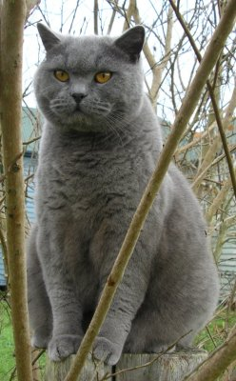
Image Classification: a core task in Computer Vision
(assume given set of discrete labels)
{dog, cat, truck, plane, ...}
cat

Slide 2

The problem:
semantic gap
Images are represented as 3D arrays of numbers, with integers between [0, 255].
E.g.
300 x 100 x 3
(3 for 3 color channels RGB)

Slide 3
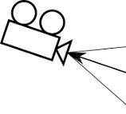
Challenges: Viewpoint Variation

Slide 4
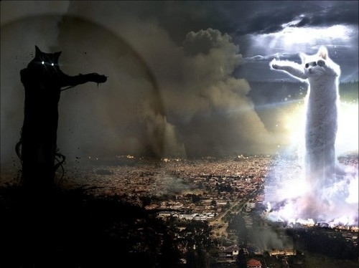
Challenges: Illumination

Slide 5

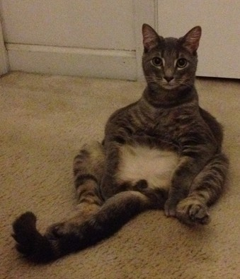

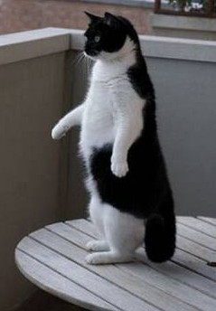
Challenges: Deformation

Slide 6
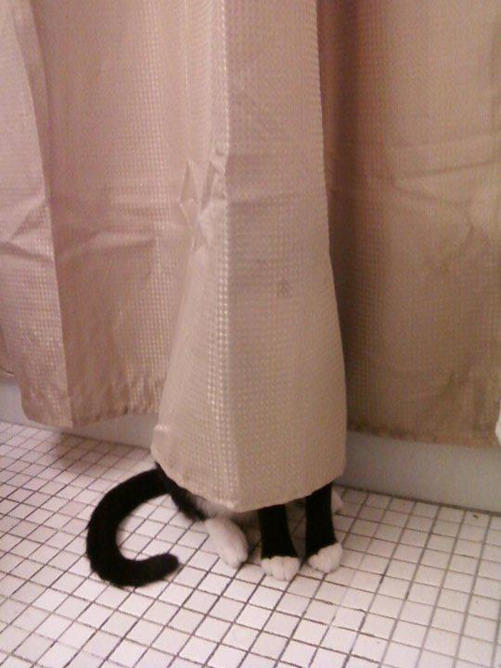
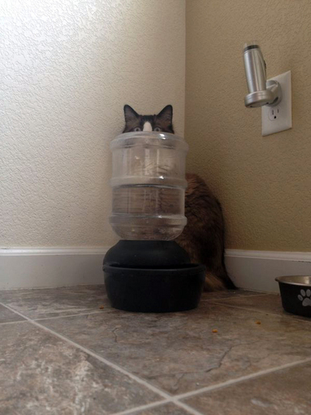
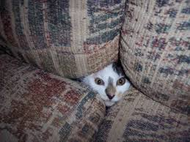
Challenges: Occlusion

Slide 7
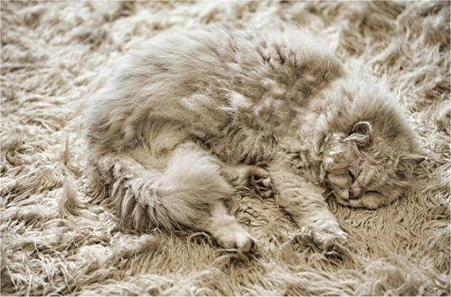
Challenges: Background clutter

Slide 8
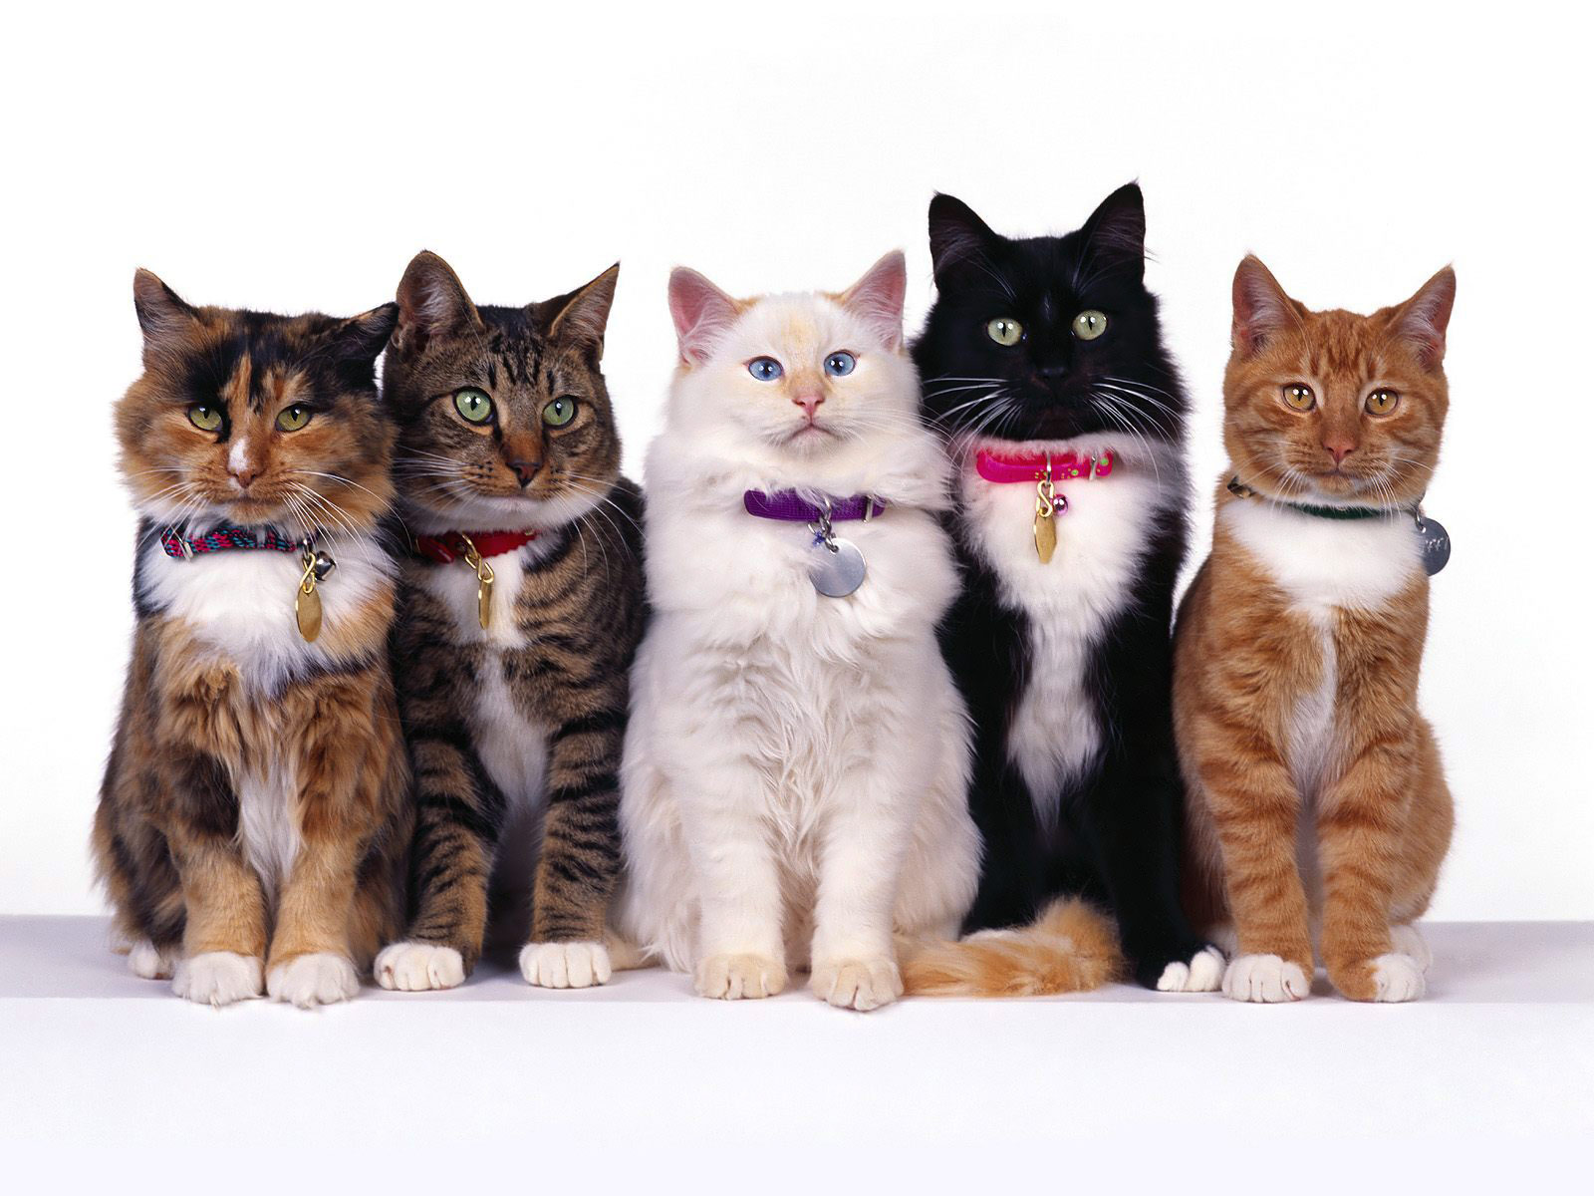
Challenges: Intraclass variation

Slide 9
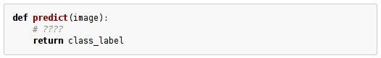
An image classifier
Unlike e.g. sorting a list of numbers,
no obvious way to hard-code the algorithm for recognizing a cat, or other classes.

Slide 10
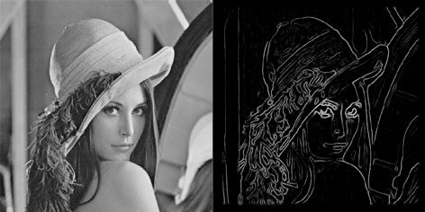
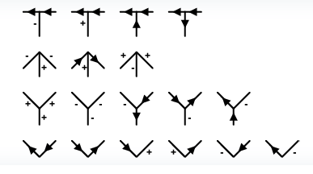
Attempts have been made
???

Slide 11
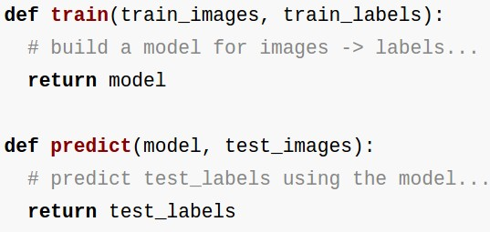
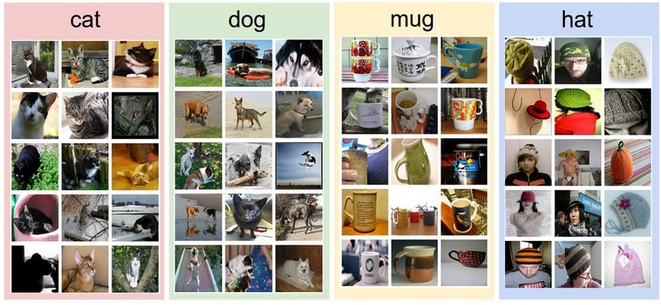
Data-driven approach:
Collect a dataset of images and labels
Use Machine Learning to train an image classifier
Evaluate the classifier on a withheld set of test images
Example training set

Slide 12
First classifier: Nearest Neighbor Classifier
Remember all training images and their labels
Predict the label of the most similar training image

Slide 13
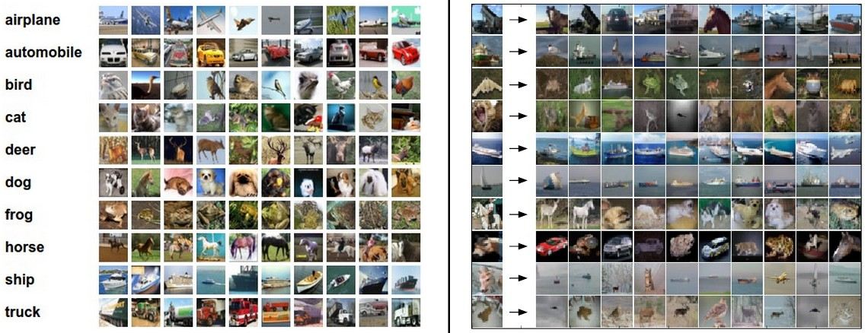
Example dataset: CIFAR-10
10 labels
50,000 training images, each image is tiny: 32x32
10,000 test images.

Slide 14
Example dataset: CIFAR-10
10 labels
50,000 training images
10,000 test images.
For every test image (first column), examples of nearest neighbors in rows

Slide 15
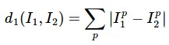
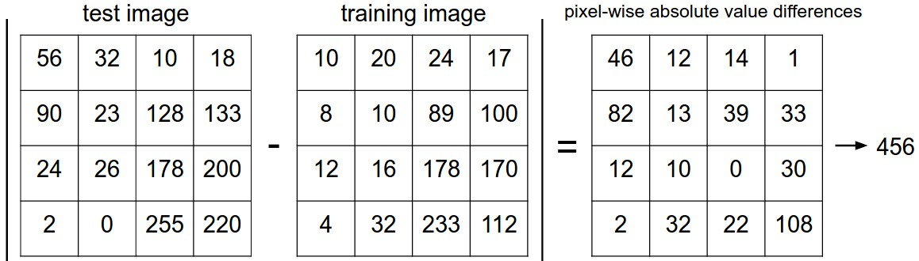
How do we compare the images? What is the distance metric?
L1 distance:
add

Slide 16
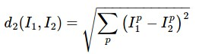
The choice of distance is a hyperparameter
common choices:
L1 (Manhattan) distance
L2 (Euclidean) distance

Slide 17
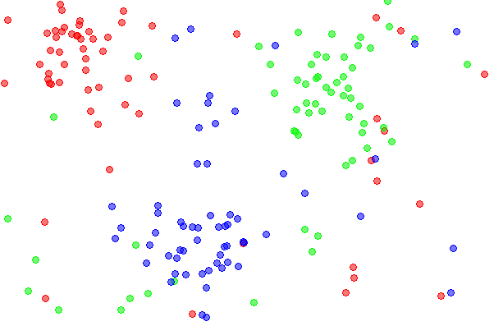
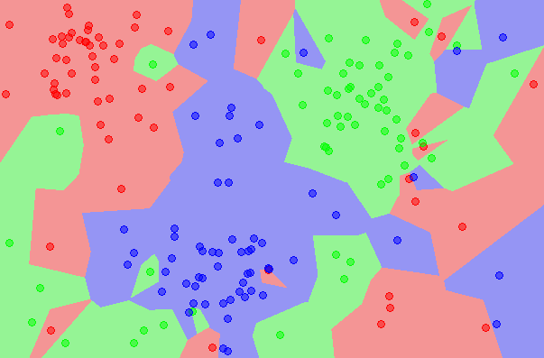
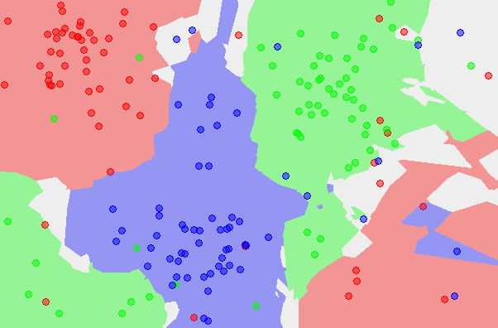
k-Nearest Neighbor
find the k nearest images, have them vote on the label
the data
NN classifier
5-NN classifier
http://en.wikipedia.org/wiki/K-nearest_neighbors_algorithm

Slide 18
Example dataset: CIFAR-10
10 labels
50,000 training images
10,000 test images.
For every test image (first column), examples of nearest neighbors in rows

Slide 19
the data
NN classifier
5-NN classifier
Q: what is the accuracy of the nearest neighbor classifier on the training data, when using the Euclidean distance?

Slide 20
the data
NN classifier
5-NN classifier
Q2: what is the accuracy of the k-nearest neighbor classifier on the training data?

Slide 21
What is the best distance to use?
What is the best value of k to use?
i.e. how do we set the hyperparameters?

Slide 22
What is the best distance to use?
What is the best value of k to use?
i.e. how do we set the hyperparameters?
Very problem-dependent.
Must try them all out and see what works best.

Slide 23
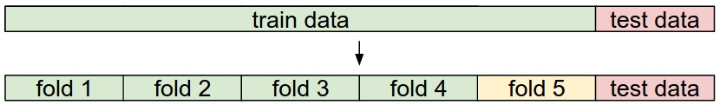
Try out what hyperparameters work best on test set.

Slide 24
Trying out what hyperparameters work best on test set:
Very bad idea. The test set is a proxy for the generalization performance!
Use only VERY SPARINGLY, at the end.

Slide 25
Validation data
use to tune hyperparameters

Slide 26
Cross-validation
cycle through the choice of which fold is the validation fold, average results.

Slide 27
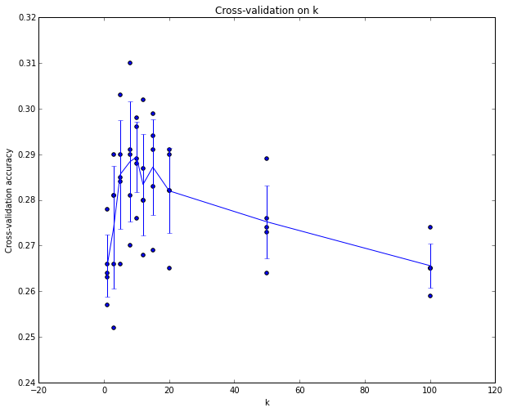
Example of
5-fold cross-validation
for the value of k.
Each point: single
outcome.
The line goes
through the mean, bars
indicated standard
deviation
(Seems that k ~= 7 works best
for this data)

Slide 28
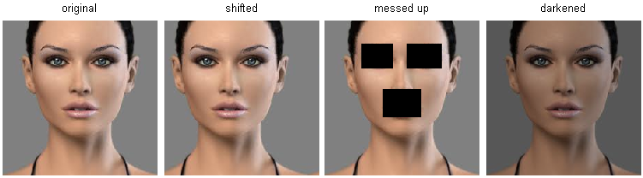
k-Nearest Neighbor on images never used.
terrible performance at test time
distance metrics on level of whole images can be very unintuitive
(all 3 images have same L2 distance to the one on the left)

Slide 29
Summary
Image Classification: We are given a Training Set of labeled images, asked to predict labels on Test Set. Common to report the Accuracy of predictions (fraction of correctly predicted images)
We introduced the k-Nearest Neighbor Classifier, which predicts the labels based on nearest images in the training set
We saw that the choice of distance and the value of k are hyperparameters that are tuned using a validation set, or through cross-validation if the size of the data is small.
Once the best set of hyperparameters is chosen, the classifier is evaluated once on the test set, and reported as the performance of kNN on that data.

Slide 30
Linear Classification

Slide 31
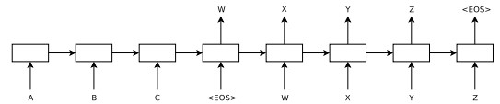
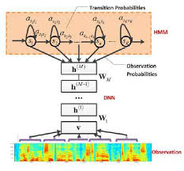
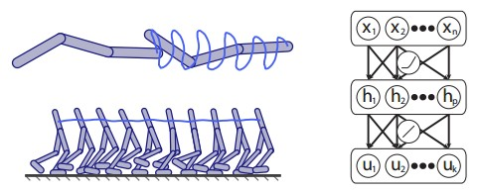

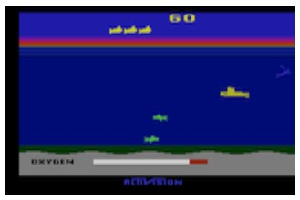
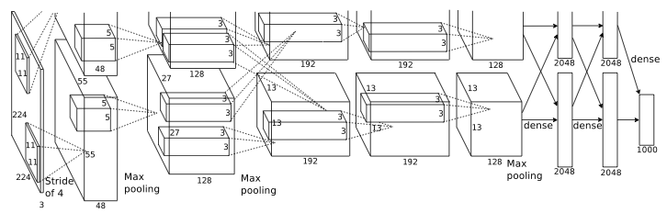
language
control
think
hear
see

Slide 32

Neural Networks practitioner

Slide 33
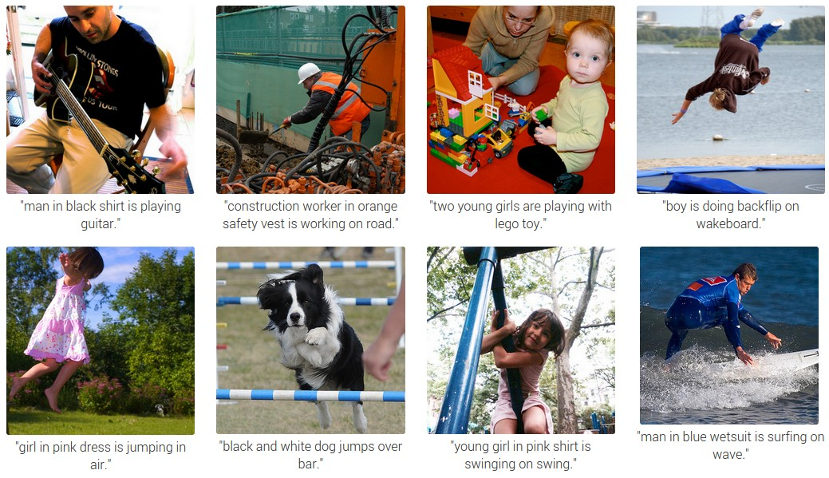

Slide 34
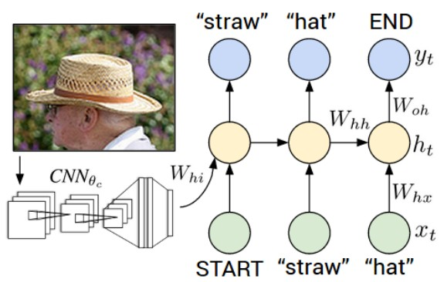
RNN
CNN

Slide 35
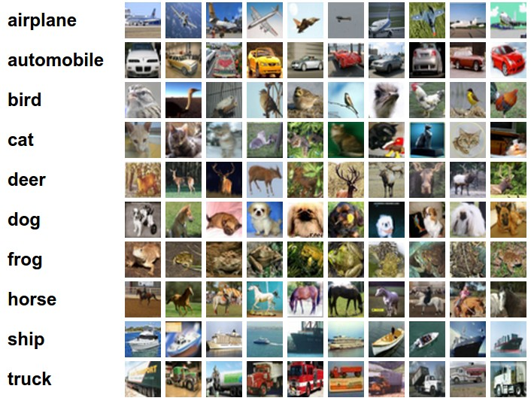
Example dataset: CIFAR-10
10 labels
50,000 training images
each image is 32x32x3
10,000 test images.

Slide 36
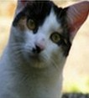
Parametric approach
image
parameters
f(x,W)
10 numbers, indicating class scores
[32x32x3]
array of numbers 0...1
(3072 numbers total)

Slide 37
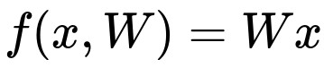
Parametric approach: Linear classifier
10 numbers, indicating class scores
[32x32x3]
array of numbers 0...1

Slide 38
Parametric approach: Linear classifier
3072x1
10x1
10x3072
10 numbers, indicating class scores
[32x32x3]
array of numbers 0...1
parameters, or “weights”

Slide 39
Parametric approach: Linear classifier
3072x1
(+b)
10x1
10x1
10x3072
10 numbers, indicating class scores
[32x32x3]
array of numbers 0...1
parameters, or “weights”

Slide 40
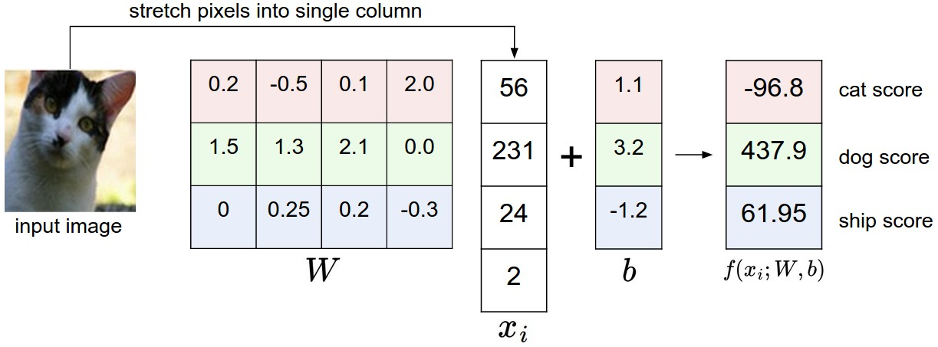
Example with an image with 4 pixels, and 3 classes (cat/dog/ship)

Slide 41
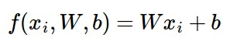
Interpreting a Linear Classifier
Q: what does the linear classifier do, in English?

Slide 42
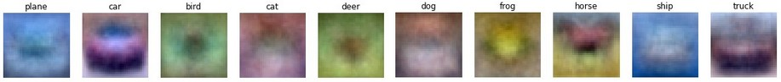
Interpreting a Linear Classifier
Example trained weights of a linear classifier trained on CIFAR-10:

Slide 43
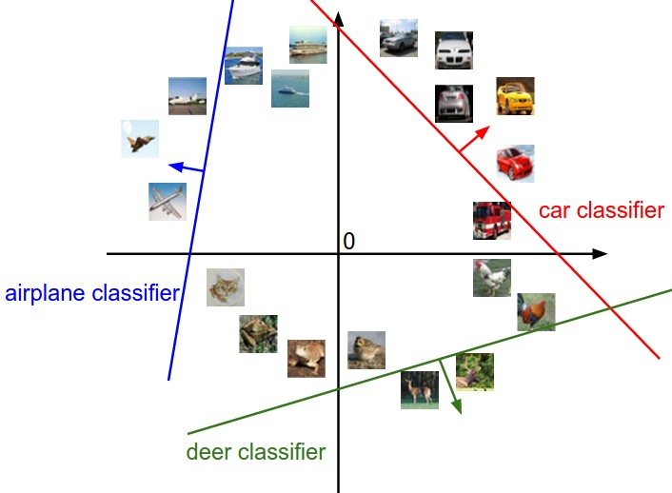
Interpreting a Linear Classifier
[32x32x3]
array of numbers 0...1
(3072 numbers total)

Slide 44
Interpreting a Linear Classifier
Q2: what would be a very hard set of classes for a linear classifier to distinguish?

Slide 45

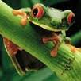
So far:
We defined a (linear) score function:
-3.45
-8.87
0.09
2.9
4.48
8.02
3.78
1.06
-0.36
-0.72
-0.51
6.04
5.31
-4.22
-4.19
3.58
4.49
-4.37
-2.09
-2.93
3.42
4.64
2.65
5.1
2.64
5.55
-4.34
-1.5
-4.79
6.14
Example class
scores for 3
images, with a
random W:

